Slide 1
HTML
<web design module=”3”>

Slide 2
HTML
Hypertext Markup Language
A programming language, the building blocks of every website.
Defines the content and structure.

Slide 3
HTML
Made up of:
Text content what you see
Markup what it looks like
References to media content
Links to other pages

Slide 4
HTML
The web browser takes the html code, interprets it and displays it.

Slide 5
HTML 5
Hypertext Markup Language
The latest set of guidelines, standards & tools that make websites more stable, beautiful & better overall.

Slide 6
HTML 5
The latest, final and complete version of HTML.
Designed to deliver almost everything you'd want to do online without requiring additional software such as browser plugins.

Slide 7
HTML 5
The main difference between HTML and HTML 5 is that video and audio are not part of HTML while these both are integral parts of HTML 5.

Slide 8




Slide 9


Slide 10


Slide 13
HTML Syntax
< element >
Notes:
They are labels that are used to identify and structure websites. HTML elements have a start tag and an end tag. It is everything from the start tag to the end tag.
Activity: Tags pairing.

Slide 14
HTML Syntax
< tag >
< /tag >

Slide 15
HTML Syntax
< tag/ >

Slide 16
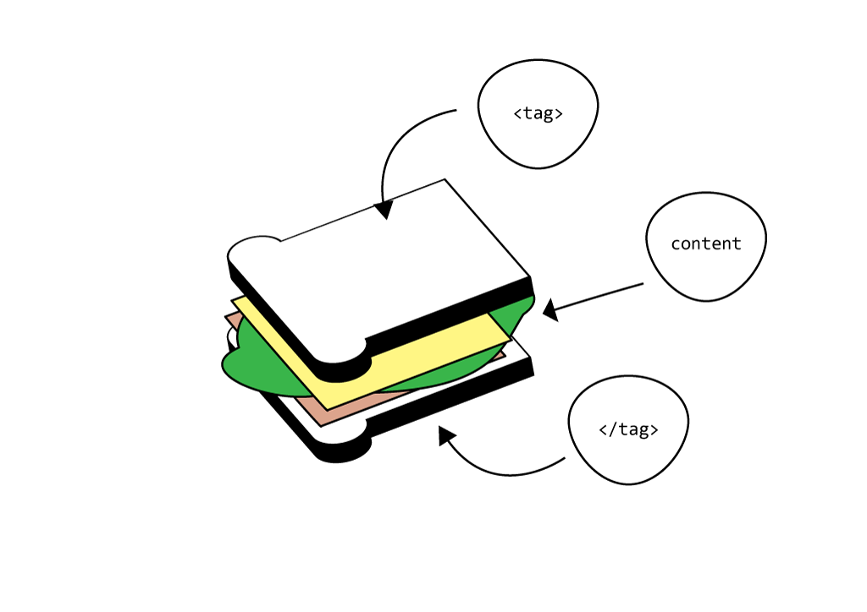
HTML Syntax

Slide 17
HTML Syntax
<tag> content </tag>

Slide 18
HTML Syntax
<image src=”mypic.jpg”>

Slide 19
HTML Syntax
<tag1>content goes<tag2>here</tag2></tag1>

Slide 20
HTML Syntax
Attribute name
Attribute value
<element attribute=”value”>content</element>
Attribute

Slide 21
Semantic Markup
Bold <b> <strong> - Makes characters appear bold. <strong> indicates strong importance, default display is bold.
Italic <i> <em> - Makes characters appear italic. <em> indicates emphasis, default display is italic.
Underline <u> - Creates an underline - being phased out.

Slide 22
Text Editors
Visual Studio, Sublime Text, PHP Storm, Atom, TextMate, etc.
Notes:
Atom videos:
https://www.youtube.com/watch?v=BQurqKG6nGY

Slide 23
Set up & creating files & folders in Text Editor
Create new folder on Desktop
Right click folder, new file - creates new tab & save as index.html
Right click folder - new folder

Slide 24
DOCTYPE Declaration
Tells the browser what type of code you will be using.

Slide 25
HTML element
It has a start tag <html> and an end tag </html>. Defines the whole document.

Slide 26
Head element
<head> Behind the scenes information about your website </head>

Slide 27
Title element
<title> </title> - used for bookmarks, history listing and SEO

Slide 28
Meta element
Describe meta data within an HTML doc. Used for SEO too.
<meta charset="UTF-8">
<meta name="description" content="Free Web tutorials">
<meta name="keywords" content="HTML,CSS,XML,JavaScript">
<meta name="author" content="Your name">
<meta name="viewport" content="width=device-width, initial-scale=1.0">

Slide 29
Body element
<body> Visible content to the end user goes here </body>
Goes after <head> and before </html>

Slide 30
Notes:
Break - 20 minutes

Slide 31
Structural Markup
Headings
<h1> <h2> <h3> <h4> <h5> <h6>
HTML has six levels of headings. h1= largest h6=smallest.
We will cover how to control these in CSS.
Only one H1 on each page - google uses this as well as meta so make it relevant.

Slide 32
Structural Markup
Create some headings
<h1>This is a Main Heading</h1>
<h2>This is a level 2 heading</h2>

Slide 33
Structural Markup
Paragraph
<p>
To create a paragraph, surround the words that make up the paragraph with <p> tags.
The browser automatically puts each paragraph on a new line.

Slide 34
Structural Markup
Create a paragraph
<p>This is a paragraph</p>

Slide 35
Structural Markup
White Space
Similarly to indenting, white space or starting code on new lines is often used to make code easier to read.
AKA - White space collapsing
The browser will read multiple spaces or a simple line break as being a single space.

Slide 36
Structural Markup for white space
Break <br>
Creates a line break, content following goes onto a new line.
Horizontal Rule <hr>
(doesn't need to be closed but if this doesn't work try </hr> which is the html5 version)
An empty element - only has one tag.
Using the </hr> tag instead of <hr> isn't essential but best practise to form good habits.

Slide 37
Semantic Markup
Strikethrough <s> - Used indicate something that is no longer relevant (i.e Was $10.00 Now $5.00)
Superscript <sup> -Used for suffix of dates or mathematical concepts.
Subscript <sub> - Used for footnotes or chemical formulas.

Slide 38
Special Characters
Some fairly standard characters cannot be used in content because they are used as HTML indicators.
These are called escape sequences and include < > and & symbols.
We can insert these characters, as well as characters not displayed on our keyboard by using character entities.

Slide 39
Special Characters
< less than = &lt;
> greater than = &gt;
& ampersand = &amp;
Cent = &cent;
$ dollar = &dollar;
© copyright = &copy;
™ trademark = &trade;
– en dash = &ndash;
— em dash = &mdash;
# number sign = &num;

Slide 40
HTML Page Structure
<html>
</html>
<head>
</head>
<title>Page Title Goes Here</title>
<body>
</body>
<h1> This is a heading </h1>
<p> This is a paragraph </p>
<p> This is another paragraph </p>
Notes:
HTML5 Structure tags pairing game
<html>
<head>
<title></title>
</head>
<body>
<nav></nav>
<main>
<section>
<h1>My First Heading</h1>
<p>My first paragraph.</p>
</section>
</main>
<footer></footer>
</body>
</html>

Slide 41
Learning Hours
Ongoing Activity Prep
Find 3-5 favourite recipes that have a list of ingredients and a step by step method
We will be using this information (from the recipe) as our content to input into our page as we go through Lists

Slide 42
Learning Hours
Emoji Submissions
Submit to me via Direct Message in Slack, a photo or illustration to represent you as an Emoji in slack.
Also, any great and appropriate icons, memes or gifs for general use.

